Slide 1

Section 1 Introduction to AI and Big Data
Fityanul Akhyar, S.T., M.T
School of Electrical Engineering Telkom University

Slide 2
Grading
Average of All Homework.
Please be an honest student and do not cheat.

Slide 3
Reference
Text Book
Python Data Science Handbook: Essential Tools for Working with Data, Jake VanderPlas, O’Reilly Media, Inc., 2016.
Chollet, Francois. Deep learning with Python. Vol. 361. New York: Manning, 2018.
Reference Book
Introduction to Machine Learning with Python: A Guide for Data Scientists 1st Edition.
Data Science and Big Data Analytics: Discovering, Analyzing, Visualizing and Presenting Data.
Website
https://www.python.org/

Slide 4
Syllabus
Introduction to AI dan Big Data
Artificial Intelligence, Concept and Application
Python 3 Programming Basic
Data Loader
Data Visualization
ANN, Random forest, SVM, and Decision Tree
Clustering
K-Means Clustering
PCA Clustering
DBSCAN Clustering

Slide 5
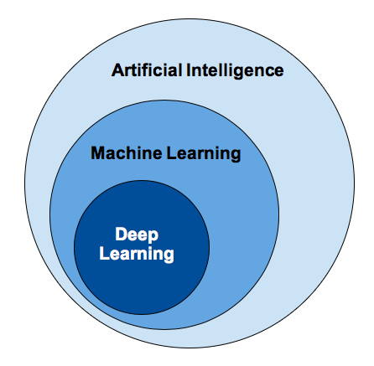
Introduction to AI
Artificial intelligence was born in the 1950s.
Although symbolic AI proved suitable to solve well-defined, logical problems, such as Playing chess, it turned out to be intractable to figure out explicit rules for solving more. Complex, fuzzy problems, such as image classification, speech recognition, and language Translation.
A new approach arose to take symbolic AI’s place: machine learning.

Slide 6
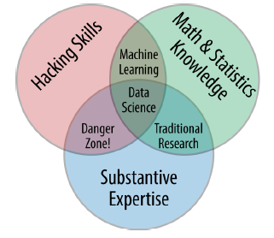
Introduction to Big Data
Data science, despite its hypeladen veneer, is perhaps the best label we have for the cross-disciplinary set of skills that are becoming increasingly important in many applications across industry and academia.
Big data is how to handle data science on a larger scale and complex, including how to extract the information and represent it.

Slide 7
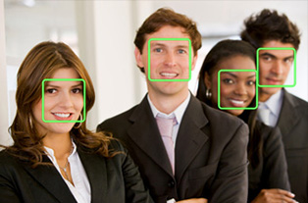
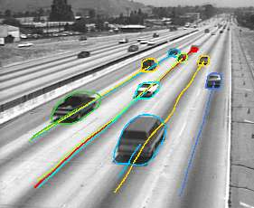
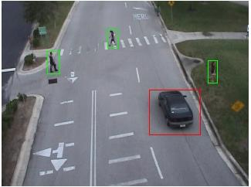


AI Application
Face detection
& Recognition
Object tracking
Moving object detection
& people counting
Others: human action recognition,
image authentication,
vehicle color identification,
abandoned object detection,
…
Rain
removal
Notes:
Chollet p.6

Slide 8
Introduction to Python
Python is an easy to learn, powerful programming language.
It has efficient high‐level data structures and a simple but effective approach to object‐oriented programming.
Simple, Easy to Learn, Free and Open Source, High‐level Language, Cross-platform, Interpreted, Object Oriented, Extensible, Embeddable, Extensive, Libraries.
Python have two version: 2.x and 3.x
In this course we use Python version 3 as our programming language.

Slide 9
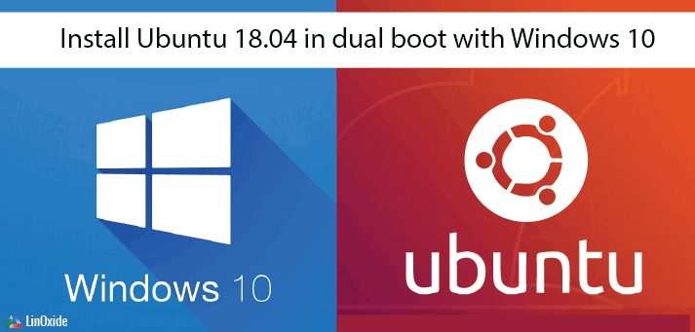
Operating System

Slide 10
Environment
Anaconda (Anaconda Distribution) is a free, easy to install package over 720 open-source packages with free community support.
Hundreds more open-source packages and their dependencies can be installed with a simple “conda install [packagename]”.
Can used on: Windows, OS X and Linux.
https://www.anaconda.com/products/individual

Slide 11
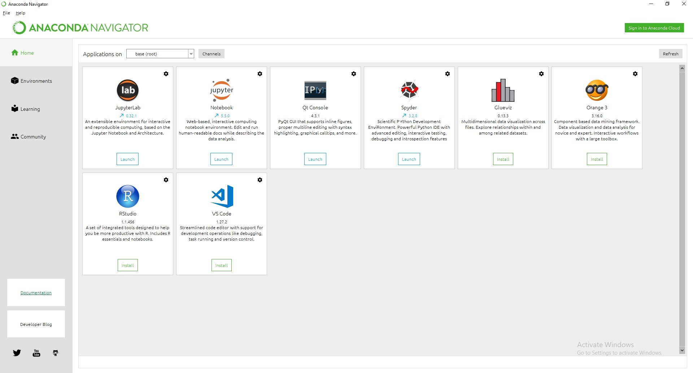
Environment

Slide 12
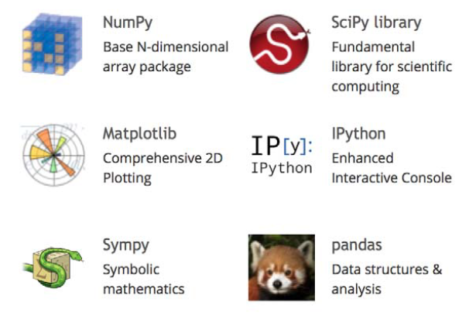
Library
SciPy (pronounced “Sigh Pie”) is a Python‐based ecosystem of open‐source software for mathematics, science, and engineering. In particular, these are some of the core packages:
https://www.scipy.org/install.html

Slide 13
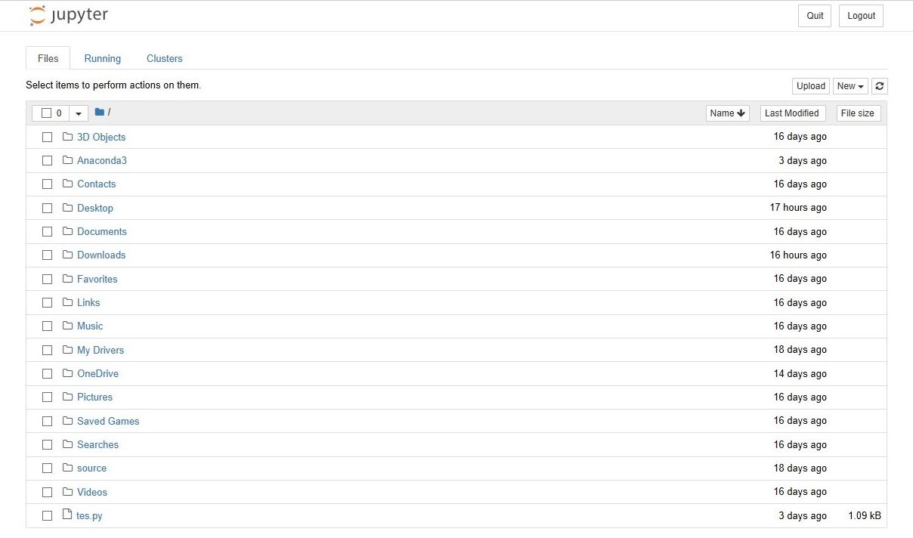
Editor
Jupyter Notebook
The Jupyter Notebook is an open-source web application that allows you to create and share documents that contain live code, equations, visualizations and narrative text.

Slide 14
Jupyter Notebook
The Jupyter Notebook is an interactive computing environment that enables users to author notebook documents that include: Live code ‐ Interactive widgets ‐ Plots ‐ text ‐ Equations ‐ Images – Video.
The Jupyter Notebook combines three components:
The notebook web application: An interactive web application for writing and running code interactively and authoring notebook documents.
Kernels: runs users’ code in a given language and returns output back to the notebook web application.
Notebook documents: Self‐contained documents that contain a representation of all content visible in the notebook web application.

Slide 15
Jupyter Notebook
notebook documents are just files on your local filesystem with a ``.ipynb`` extension.
Notebooks consist of a linear sequence of cells. There are four basic cell types:
Code cells: Input and output of live code that is run in the kernel
Markdown cells: Narrative text with embedded LaTeX equations. Markdown is a popular markup language that is a superset of HTML. Google to find the specification.
Heading cells: 6 levels of hierarchical organization and formatting.
Raw cells: Unformatted text.

Slide 16
Jupyter Notebook
Markdown supports two styles of headers, Setext and atx.
Setext‐style headers are “underlined” using equal signs (for first‐level headers) and dashes (for second‐level headers). For example:
This is an H1
=============
This is an H2
‐‐‐‐‐‐‐‐‐‐‐‐‐
Atx‐style headers use 1‐6 hash characters at the start of the line, corresponding to header levels 1‐6. For example:
# This is an H1
## This is an H2
###### This is an H6

Slide 17
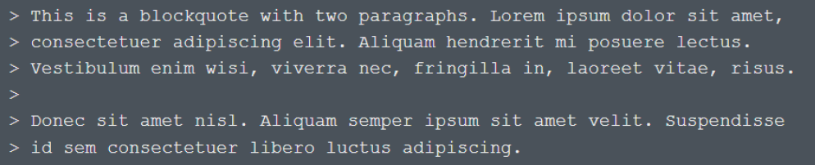
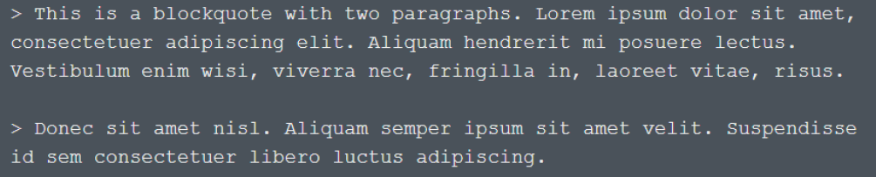
Jupyter Notebook
Markdown uses email‐style right angle bracket > characters for blockquoting. For example:
Markdown allows you to be lazy and only put the > before the first line of a hardwrapped paragraph:

Slide 18
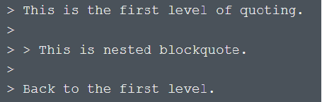
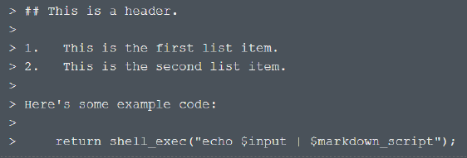
Jupyter Notebook
Blockquotes can be nested (i.e., a blockquote‐in‐a‐blockquote) by adding additional levels of >:
Blockquotes can contain other Markdown elements, including headers, lists, and code blocks:

Slide 19
Jupyter Notebook
Blockquotes can be nested (i.e., a blockquote‐in‐a‐blockquote) by adding additional levels of >:
Blockquotes can contain other Markdown elements, including headers, lists, and code blocks:

Slide 20
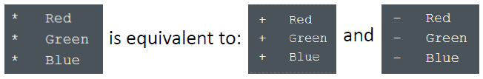
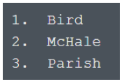
Jupyter Notebook
Markdown supports ordered (numbered) and unordered (bulleted) lists.
Unordered lists use asterisks, pluses, and hyphens — interchangably — as list markers:
Ordered lists use numbers followed by periods:
List items may consist of multiple paragraphs.
Each subsequent paragraph in a list item must be indented by either 4 spaces or one tab.

Slide 21
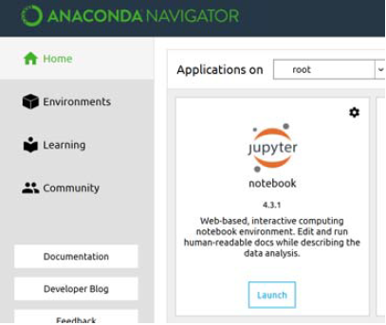
Jupyter Notebook
You have two options to run Jupyter Notebook:
From Anaconda Navigator: Click on “Launch” of “jupyter‐notebook”.
Or Go to your terminal and change to the directory you wish to work in. Type: jupyter notebook.

Slide 22
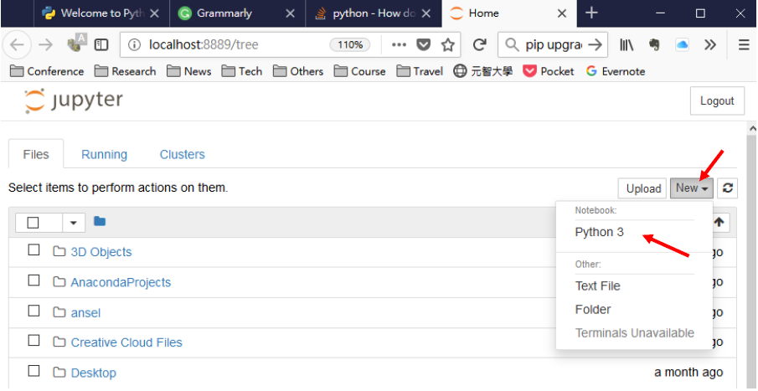
Jupyter Notebook
Click ‘New’ → ‘Python 3’ to start a new notebook:

Slide 23
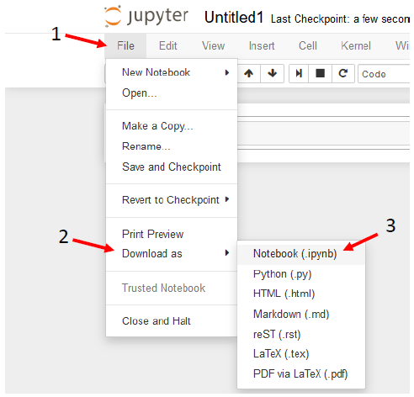
Jupyter Notebook
Usually, you can find your ipynb files in c:\Users\[your username]

Slide 24
Homework 1
Install Anaconda Environment on Your System
Create Notebook with following format:
homework no: [Markdown cell]
name: student ID: [Markdown cell]
( x ) My reference (if yes): name and student id Markdown cell]
( v ) I totally write by myself
Code and output [Code cell]
Your Comments [Markdown cell]
Explain more about AI and Big Data, From the history until the current application.
note that your filename is like this hw4_1071234.ipynb, all lowercase letters, and no prefix 's' to your student ID. Just ipynb file. Do not compress your file.

Slide 25
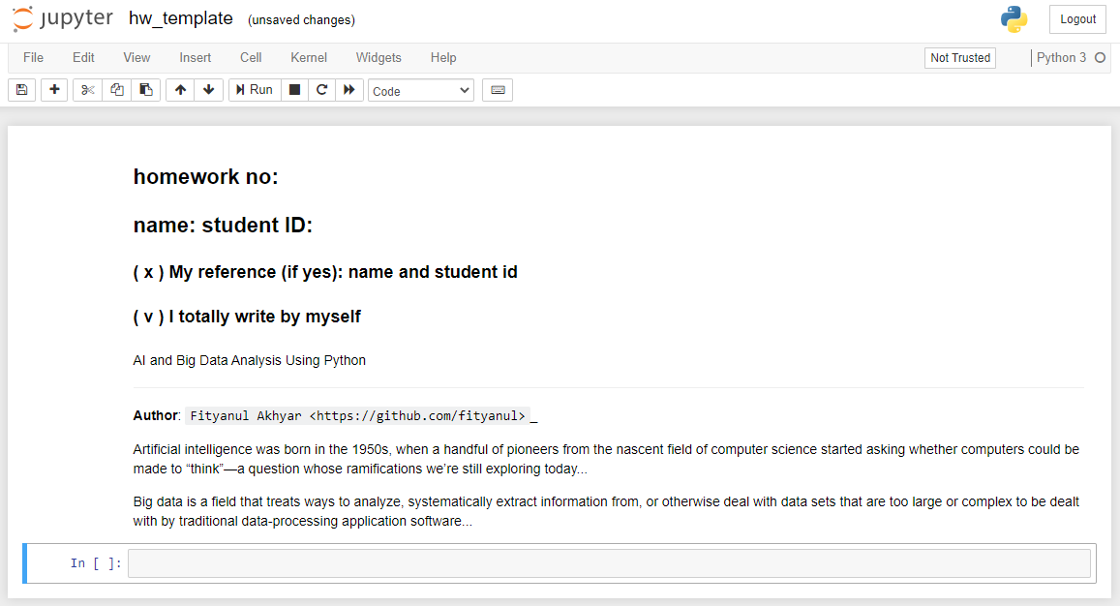
Homework 1

Slide 26
Terima Kasih

